Slide 1

Developing Prolog Coding Standards
Michael A. Covington
Institute for Artificial Intelligence

Slide 2
Copyright 2011
Michael A. Covington and/or
The University of Georgia
Reuse or redistribution without the author’s permission is prohibited by law.

Slide 3
Based on a paper…
Coding Guidelines for Prolog
Michael A. Covington
Roberto Bagnara
Richard A. O’Keefe
Jan Wielemaker
Simon Price
forthcoming in
Theory and Practice of Logic Programming

Slide 4
Based on a paper…
5 authors
>5 opinions!
My goal is to
get you thinking,
not dictate practices to you.

Slide 5
Developing Prolog coding standards
Motivation
Layout
Naming conventions
Documentation
Peculiarities of Prolog
Debugging and testing
Conclusions

Slide 6
Developing Prolog coding standards
Motivation
Layout
Naming conventions
Documentation
Peculiarities of Prolog
Debugging and testing
Conclusions

Slide 7
Motivation
Everybody knows this now,
but it was once news:
Programming languages are for
human beings, not for computers.
The computer would be content with
0100011110001110001111100101010011…

Slide 8
Motivation
Good coding standards
Make the program easier to read (and debug)
Eliminate meaningless variation (so that all changes in layout are significant)
Make different programmers’ contributions look alike (for coherence of a large project)

Slide 9
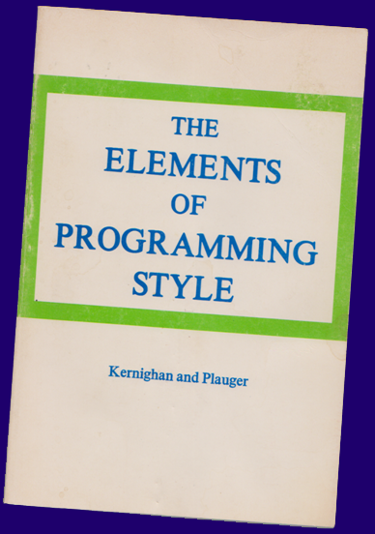
Motivation
1974…

Slide 10
Motivation
Kernighan and Plauger’s key insight:
Writing programs for a human audience
not only
makes them easier to read,
it makes them more reliable
and even makes them run faster!
(Style ➔ thinking about what you’re writing.)

Slide 11
Motivation
Your audience might even be
yourself
2 minutes or 2 decades later.

Slide 12
Motivation
So how do we apply
all of this
to Prolog?

Slide 13
Developing Prolog coding standards
Motivation
Layout
Naming conventions
Documentation
Peculiarities of Prolog
Debugging and testing
Conclusions

Slide 14
Layout
The most important thing about
program layout
is to care about it
and find some way
to be neat and consistent.

Slide 15
Layout
Semantic principle well known to the
printing industry:
Readers will expect every change in layout
to mean something.
If it doesn’t, you’re asking them to
process noise.

Slide 16
Layout
foo :- blah,
blither,
blither2,
blatt.
Nobody can look at this without wondering
why 2 subgoals are indented further.
If there’s no reason, you’ve annoyed them.

Slide 17
Layout
Indent consistently, preferably by 4 spaces.
Put each subgoal on a separate line.
ord_union_all(N, Sets0, Union, Sets) :-
A is N / 2,
Z is N – A,
ord_union_all(A, Sets0, X, Sets1),
ord_union_all(Z, Sets1, Y, Sets),
ord_union(X, Y, Union).

Slide 18
Layout
Consider using a proportional-pitch font.
More readable, and less like an 80-column punched card!
ord_union_all(N, Sets0, Union, Sets) :-
A is N / 2,
Z is N – A,
ord_union_all(A, Sets0, X, Sets1),
ord_union_all(Z, Sets1, Y, Sets),
ord_union(X, Y, Union).

Slide 19
Layout
Make your editor store the indentations
as spaces, not tabs,
so they won’t change when the file is
opened with another editor.

Slide 20
Layout
Limit the lengths of lines
(the printing industry says 55 characters;
computer industry standard of 80
is definitely too big).

Slide 21
Layout
Limit the number of lines per predicate
(break up complex ones as needed).
Use more vertical space between
different predicates than between
clauses of the same predicate.

Slide 22
Layout
Arrange comments for readability.
Don’t write lists as continuous prose.
% This predicate classifies C as whitespace (ASCII < 33),
% alphabetic (a-z, A-Z), numeric (0-9), or symbolic (all
% other characters).
% This predicate classifies C as:
% - whitespace (ASCII < 33);
% - alphabetic (a-z, A-Z);
% - numeric (0-9); or
% - symbolic (all other characters).

Slide 23
Layout
Space after commas that separate
goals or arguments, but not list elements.
pred([A,B], [D,E]) :-
goal(A, D),
goal(B, E).
The comma has 3 uses in Prolog,
and any help disambiguating it is welcome.

Slide 24
Layout
Make semicolons and if-then-elses
very prominent through indentation.
pred(A) :- One of several ways to do it
(test1(A) ->
goal1(A)
;
goal2(A)
).
Most of us have been trained to overlook semicolons!

Slide 25
Layout
Consider using a prettyprinter
for hardcopy.
Consider implementing a good
prettyprinter for us, if you’re so inclined!
Or at least fix up my old PLTeX…

Slide 26
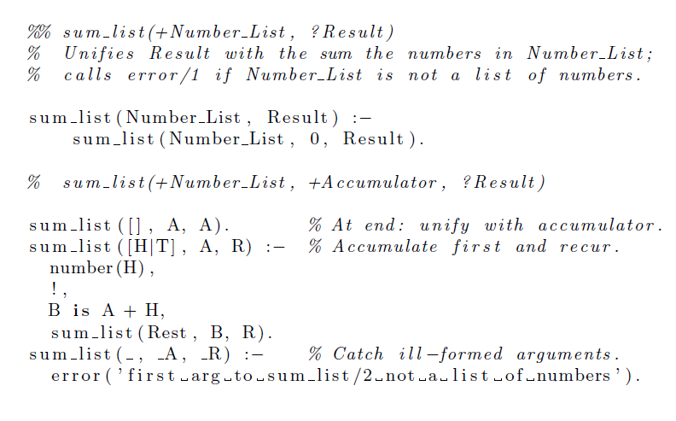
Prettyprinter: LaTeX “listings” package

Slide 27
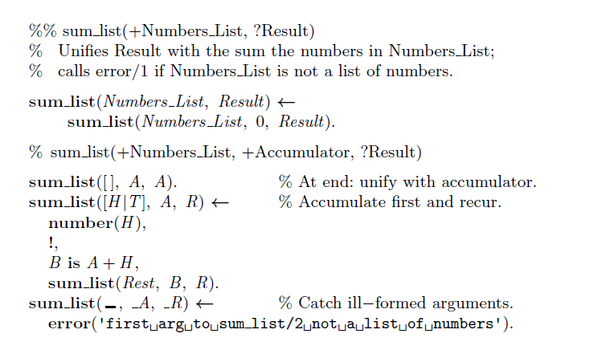
Prettyprinter: Covington’s PLTeX

Slide 28
Developing Prolog coding standards
Motivation
Layout
Naming conventions
Documentation
Peculiarities of Prolog
Debugging and testing
Conclusions

Slide 29
Naming conventions
Don’t worry, the rest of the sections
of this talk
are going to be a bit shorter!

Slide 30
Naming conventions
Capitalization practices are imposed on us
by Prolog syntax.
Variables begin with capital letters.
Atoms and predicate names begin with lowercase letters.
(I know there are ways to get around this…)

Slide 31
Naming conventions
Use underscores to
separate words in names.
Like_This
like_this

Slide 32
Naming conventions
Make names meaningful.
To convey “sort the list and count its elements”
name your predicate
sort_and_count, not stlacie.
To avoid typing long names,
use a short name temporarily,
then search-and-replace.

Slide 33
Naming conventions
Make all names pronounceable.
xkcd is a good name for a comic strip –
not for a Prolog predicate.
Don’t use multiple names
likely to be pronounced alike.
People remember pronunciations, not spellings.
Worst I’ve ever seen: MENU2, MENUTWO, MENUTOO.

Slide 34
Naming conventions
Within names, don’t express
numbers as words.
pred1, pred2 not pred_one, pred_two
This is a tactic to make spellings
predictable from pronunciations.

Slide 35
Naming conventions
Don’t use digits for words.
list_to_tree not list2tree
unless you’re going for a
high-school L33TSP33K look!

Slide 36
Naming conventions
Mark auxiliary predicates with suffixed
_aux, _loop, _case, _1, _2
or the like.
foo(…) :- …, foo_aux(…), …
foo_aux(…) :- …

Slide 37
Naming conventions
If a predicate tests a property or relation,
give it a name that is not a command to
do something.
sorted_list, parent
well_formed, ascending
between_limits
contains_duplicates, has_sublists

Slide 38
Naming conventions
If a predicate is best understood as
an action, give it a name that is
a command to do something.
remove_duplicates
print_contents
sort_and_classify

Slide 39
Naming conventions
Choose predicate names to help show
the argument order.
parent_child(X,Y)
rather than
parent(X,Y)
(which is the parent of which?)

Slide 40
Naming conventions
Use descriptive variable names
Input_List, Tree, Result, Count
Decide how to use single-character names
For very localized use:
C could be a single character
I, J, K, M, N could be integers
L could be a list

Slide 41
Naming conventions
Establish practices for naming
threaded state variables
(intermediate results).
foo(State0, State) :-
foo_step(State0, State1),
foo(State1, State).
No digit after the final name.

Slide 42
Naming conventions
Singular and plural are often handy
for the first and rest of a list.
[Tree|Trees] or even [T|Trees]
Avoid
[First|Rest], [Head|Tail], [H|T]
unless you really can’t say what is in the list.

Slide 43
Developing Prolog coding standards
Motivation
Layout
Naming conventions
Documentation
Peculiarities of Prolog
Debugging and testing
Conclusions

Slide 44
Documentation
Begin every predicate (except auxiliary
predicates) with a descriptive comment.
%% remove_duplicates(+List, -Processed_List) is det
%
% Removes the duplicates in List, giving Processed_List.
% Elements are considered to match if they can
% be unified with each other; thus, a partly uninstantiated
% element may become further instantiated during testing.
% If several elements match, the last of them is preserved.
If you can’t do this, you’re not ready to code the predicate.

Slide 45
Documentation
Use meaningful names and mode
specifiers on arguments in the comment.
%% remove_duplicates(+List, -Processed_List)
Simplest system:
+ expected to be instantiated upon entry
- expected not to be instantiated upon entry
? may or may not be instantiated upon entry

Slide 46
Documentation
You can also specify determinism…
%% remove_duplicates(+List, -Processed_List) is det
det Succeeds exactly once and leaves no backtrack points.
semidet Either fails or is det.
nondet May either fail or succeed any number of times, may leave backtrack points.
multi Like nondet but must succeed at least once.

Slide 47
Documentation
Auxiliary predicates do not need
full descriptive comments.
That’s why they’re auxiliary –
they’re not called from elsewhere.
But always leave enough comments
to make it clear what you’re doing.

Slide 48
Developing Prolog coding standards
Motivation
Layout
Naming conventions
Documentation
Peculiarities of Prolog
Debugging and testing
Conclusions

Slide 49
Peculiarities of Prolog
Predicates should be steadfast.
That is, behavior should not change if
the output argument is already
instantiated to the right value.
?- foo(X), X = something.
?- foo(something).

Slide 50
Peculiarities of Prolog
Put arguments in this order:
inputs, intermediate values, outputs.
Confusing in C:
fprintf(stream, format, args)
fgets(string, number, stream)
Let’s not repeat that folly.

Slide 51
Peculiarities of Prolog
Put the most discriminating argument first.
That is, put first the one that is most likely
already to be instantiated to a value
that enables you to choose clauses.
That’s first-argument indexing!

Slide 52
Peculiarities of Prolog
Never add a cut to correct an
unknown problem.
Instead, make your program logic correct
without the cut, and then
trim away unneeded searches.
Beginners often misunderstand the cut.

Slide 53
Peculiarities of Prolog
Work at the beginning of the list.
You can get to the first element
immediately; to get to the last element
you must traverse all the others.
Sometimes this means it’s better
to build a list backward.

Slide 54
Peculiarities of Prolog
Remember this idiom:
process_list([Old|Olds], [New|News]) :-
do_something_to_element(Old, New),
process_list(Olds, News).
process_list([], []).
This traverses the lists forward and is
tail recursive. It is efficient.

Slide 55
Peculiarities of Prolog
Avoid append, assert, retract
when speed is important.
These are slower than most Prolog actions.
You may use them in prototyping
and then modify the algorithm
to speed it up when needed.

Slide 56
Peculiarities of Prolog
Prefer tail recursion, but don’t be fanatical.
A recursive call is tail recursive if
it is the last step of a predicate and
there are no backtrack points left behind.
This saves memory – it is compiled as iteration.
Think about this if a predicate must recurse
1000 times – don’t worry if it’s just 10.

Slide 57
Developing Prolog coding standards
Motivation
Layout
Naming conventions
Documentation
Peculiarities of Prolog
Debugging and testing
Conclusions

Slide 58
Debugging and testing
The best code is the one that
does the right computation,
not the one with the most tricks.
Don’t be clever.
Read the source code of UNIX and you
will marvel at how un-clever it really is.

Slide 59
Debugging and testing
When efficiency is critical, make tests.
Perform “microbenchmarks”
to find out which way of doing something
is actually faster
with your compiler.
Use built-in predicate: statistics.

Slide 60
Debugging and testing
Look out for constructs that are
nearly always wrong.
! at end of last clause of a predicate
repeat not followed by !
append with a one-element list as its first argument

Slide 61
Debugging and testing
Use the built-in debugger
(spy, trace).
It’s in all the textbooks,
and it still works.

Slide 62
Debugging and testing
Use print (not write) to add
tracing output to your program.
print is more user-configurable than
write (e.g., can abbreviate long lists, or
handle other data specially, or even keep
quiet entirely under specified conditions).

Slide 63
Debugging and testing
Test that every loop or repetition:
Starts correctly,
Advances correctly from one
step to the next,
Ends correctly.
This applies to all programming languages.

Slide 64
Debugging and testing
Test every predicate by failing back into it.
Does it do something unexpected when
you make it backtrack?
Don’t just test: ?- my_pred(my_arg).
Test also: ?- my_pred(my_arg), fail.
Getting one solution is not enough!

Slide 65
Debugging and testing
In any error situation, either
correct the problem or
make the program crash (not just fail).
Prolog’s “failure” means “The answer is no.”
It does not mean “I can’t do the computation.”

Slide 66
Debugging and testing
Make error messages meaningful.
“Cannot sort a(b,c) because it is not a list”
not
“Illegal argument, wrong type”

Slide 67
Debugging and testing
Don’t waste time checking for errors
that would be caught anyway,
such as arithmetic on non-numbers.
Prolog is an untyped language.
Don’t make the CPU spend all its time
checking types on the remote chance
that they might be wrong.

Slide 68
Developing Prolog coding standards
Motivation
Layout
Naming conventions
Documentation
Peculiarities of Prolog
Debugging and testing
Conclusions

Slide 69
Conclusions
If you’re ready to disagree with
a good bit of what I said,
I’ve done my job.
I’ve started you thinking.

Slide 70
Conclusions
There is no “one true style” for Prolog.
Coding standards are something
you (singular or plural)
need to develop on your own
and even change when the need arises.

Slide 71
Conclusions
But it is much better to have
consistent habits that you can change
than to have no consistent habits!

Slide 72
Developing Prolog coding standards
?

